Slide 1
CO-CURRICULAR / EXTRA CURRICULAR CERTIFICATE 2023-2024
Name: DEEPAN SAKKARAVRTHI.S
DEPT: CSE-A
ROLL NO: 21UCS010

Slide 2
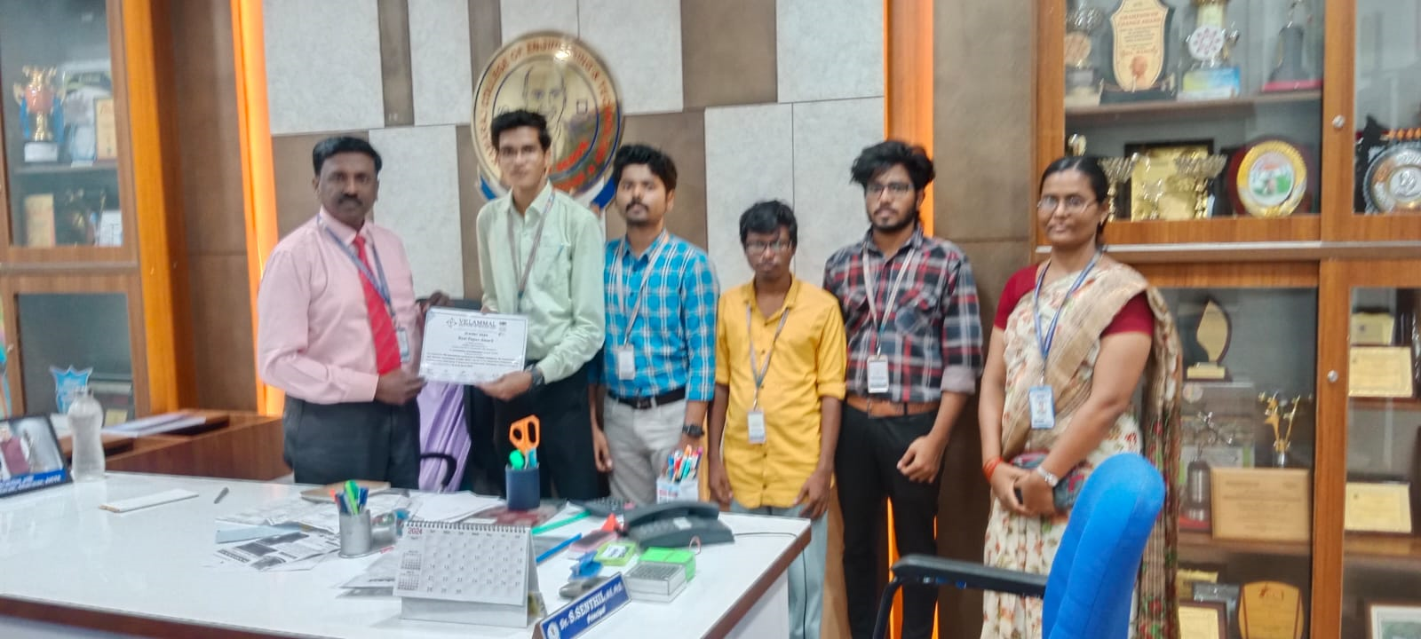
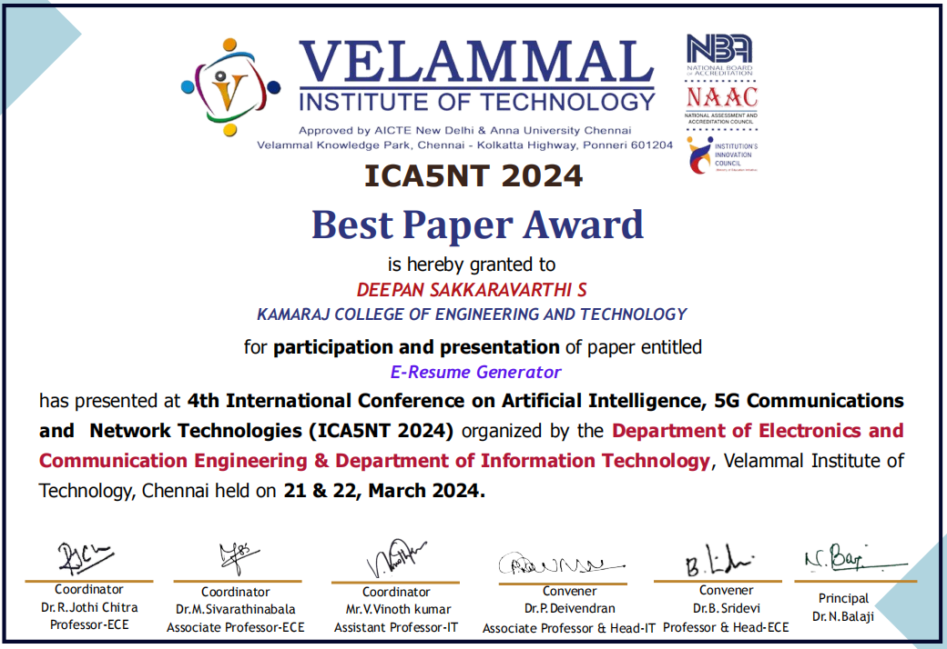
BEST PAPER AWARD-VELAMMAL
In the 4th International Conference on Artificial intelligence, 5G Communication and Network Technologies (ICA5NT 2024) conducted by Velammal Institute of Technology , Chennai, Where I received the Best paper Award for the project “E-RESUME GENERATOR”
using Django framework.

Slide 3
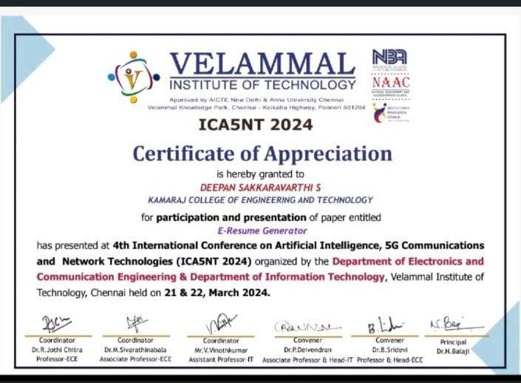

PAPER PRESENTATION- VELAMMAL
Presented my project paper entitled “E-RESUME GENERATOR”. In Velammal institute of Technology - Chennai. Our project will act as a guiding force and also a helpful website for jobseekers to create their attractive and informative resume.

Slide 4
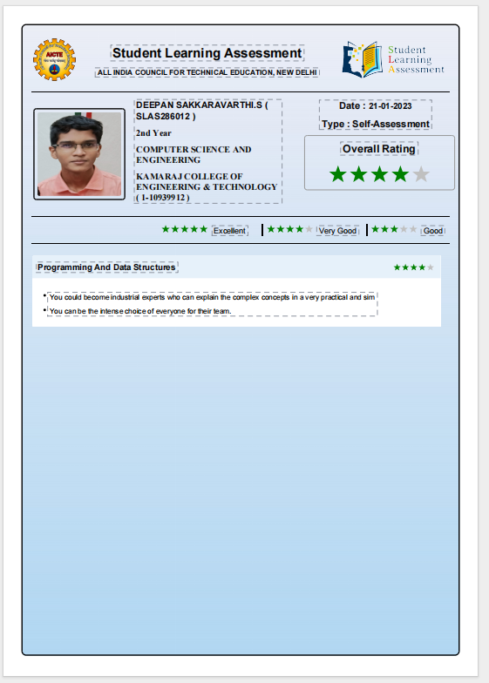
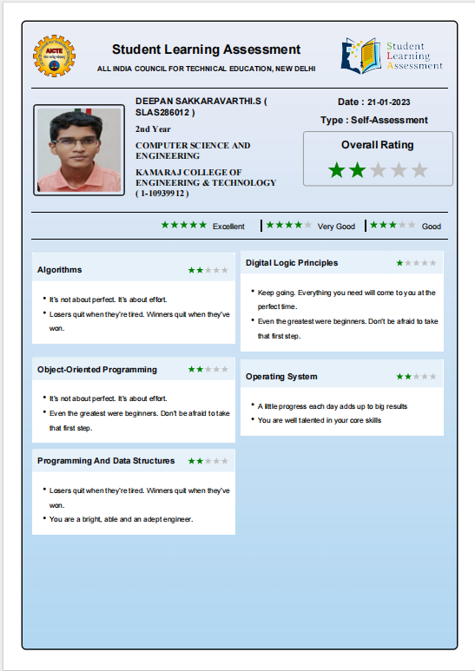

AICTE- ASSESMENTS
Completed AICTE - SLAP assesments for 2&3 year in 2023.

Slide 5
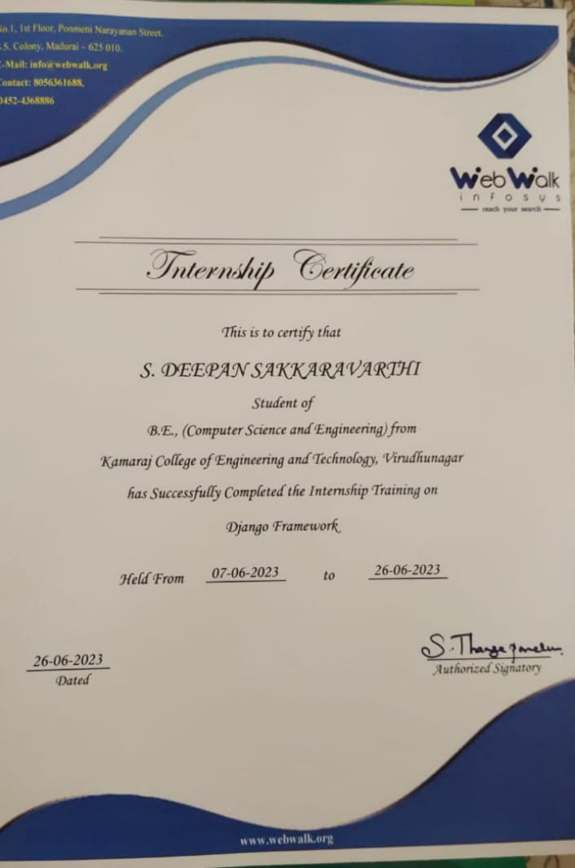

INTERNSHIP
Attended internship at “WEB WALK INFOSYS” and completed 17 days Training on Django Framework.

Slide 6

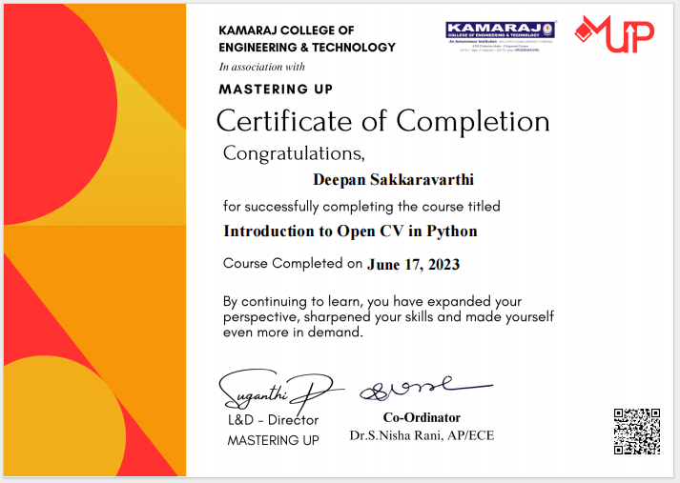
WEBMINAR
Attended webminar with Mastering UP associated with our institute in addition to that. I have learnt how to use “Open CV in python” and learnt about the tool used for image processing and performing computer vision tasks.

Slide 7
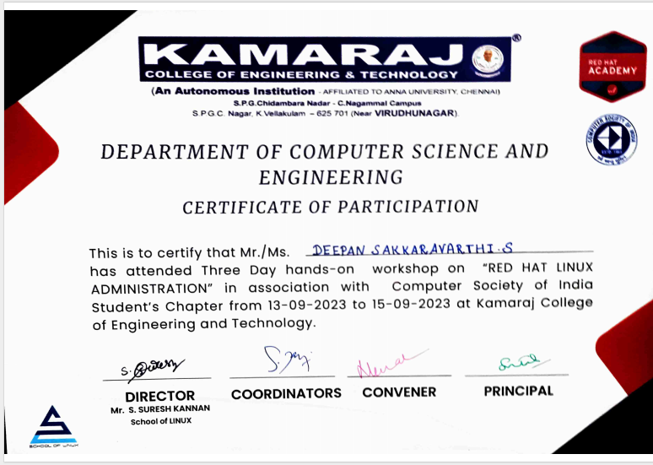

WORK SHOP- RED HAT LINUX
Attended three day hands-on workshop on “RED HAT LINUX” and learnt to work with linux environment via command line interface by using linux commands.

Slide 8
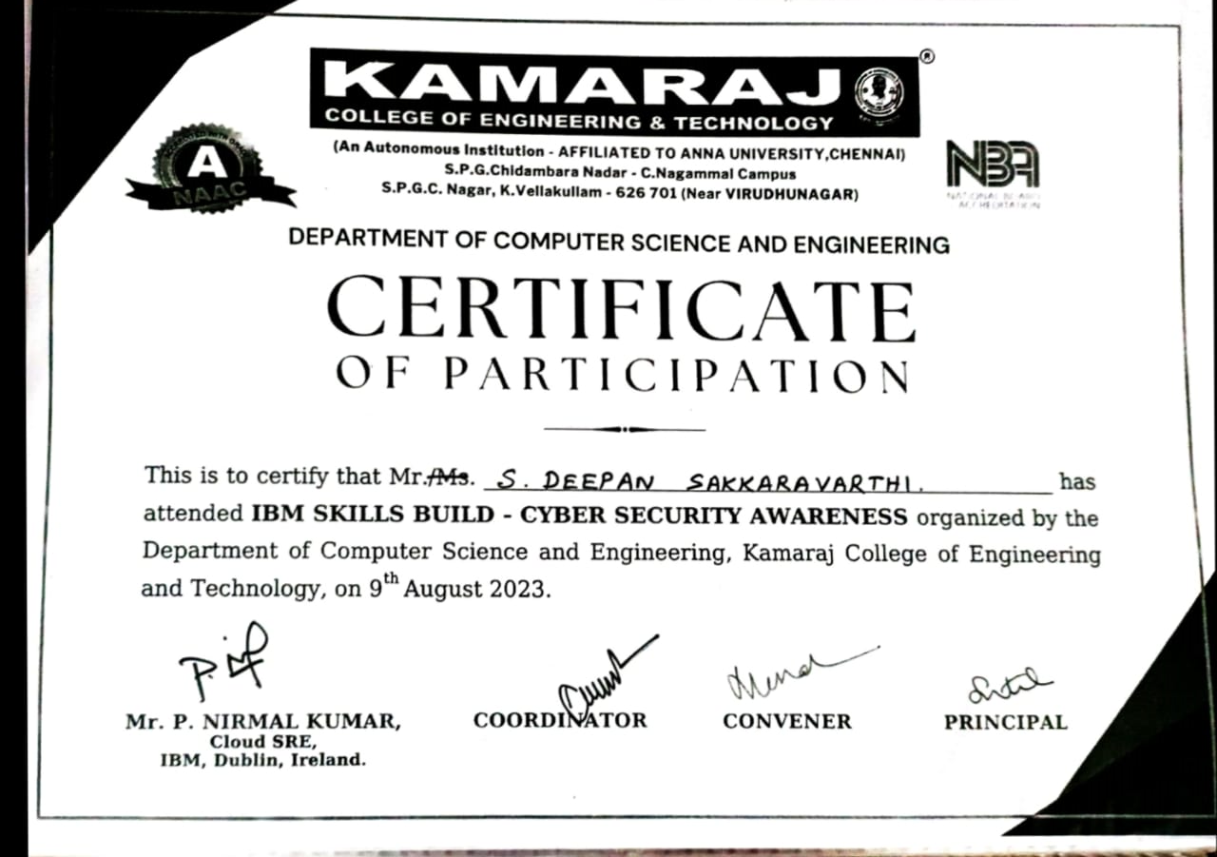

AWARENESS PROGRAM
Attended Cyber awareness program provided by IBM and organized in our college

Slide 9
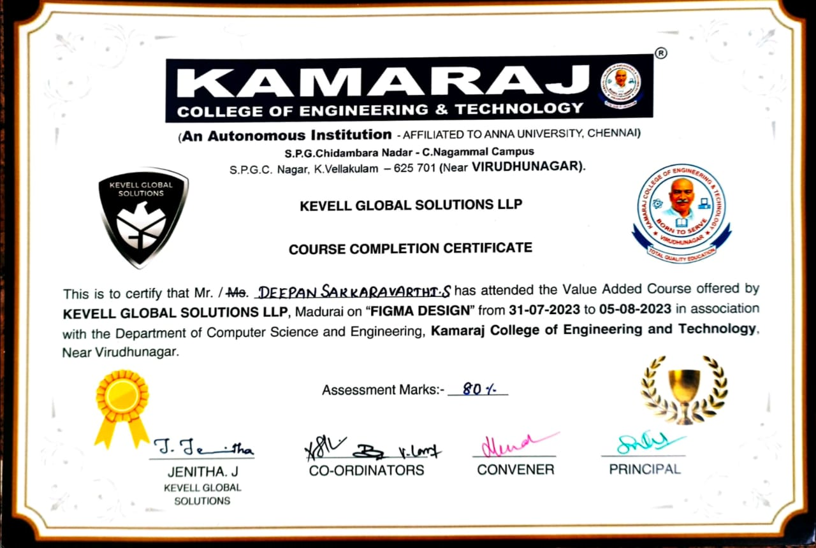

VALUE ADDED COURSE ON FIGMA
Attended 6 Days hands-on value added course on “UI UX design” using figma designing tool offered by KEVELL GLOBAL SOLUTIONS.

Slide 10
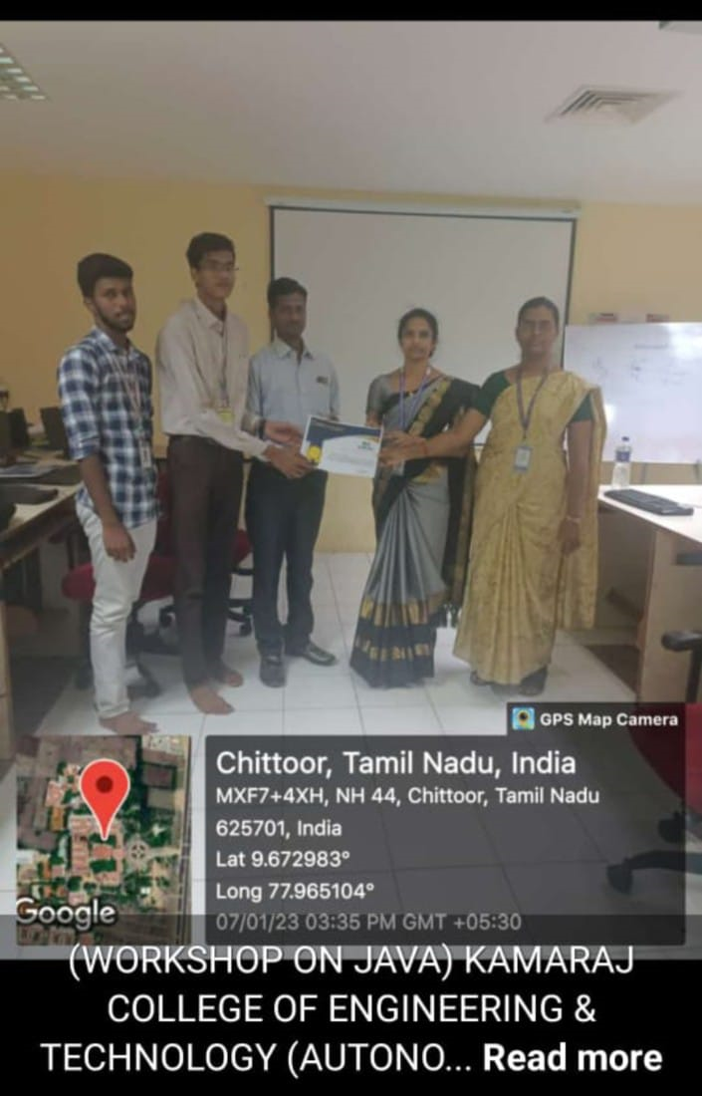

VALUE ADDED COURSE ON JAVA
Attended 6 Days Value Added Course on “Advanced java” offered by VEI technologies and learnt efficient OOPS and logical concepts in java programming language.

Slide 11
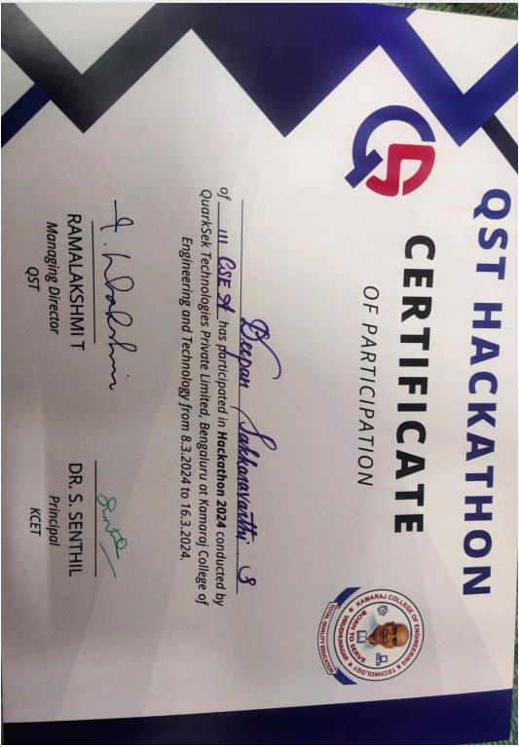

HACKATHON
Attended a Techlevel Hackathon organized in our college by Quarseck for the departments of CSE, IT, AI&DS. In which we have selected automated pen testing software as Case 1. In that I have received Certificate for taking part in the Tech challenge.

Slide 12
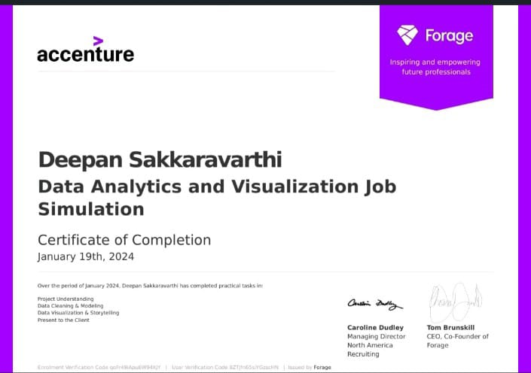

CERTIFICATION ON ACCENTURE
I have completed Accenture North America's Data Analytics and Visualization on Forage. In the simulation I: Completed a simulation focused on advising a hypothetical social media client as a Data Analyst at Accenture Cleaned, modelled and analyzed 7 datasets to uncover insights into content trends to inform strategic decisions Prepared a PowerPoint deck and video presentation to communicate key insights for the client and internal stakeholders.

Slide 13
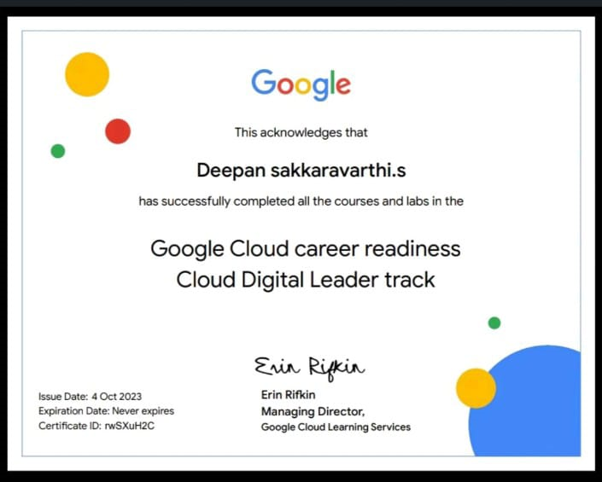

CERTIFICATION ON GOOGLE
I had received the certificate of Cloud Digital Leader track from “Google Cloud Skills boost”.

Slide 14
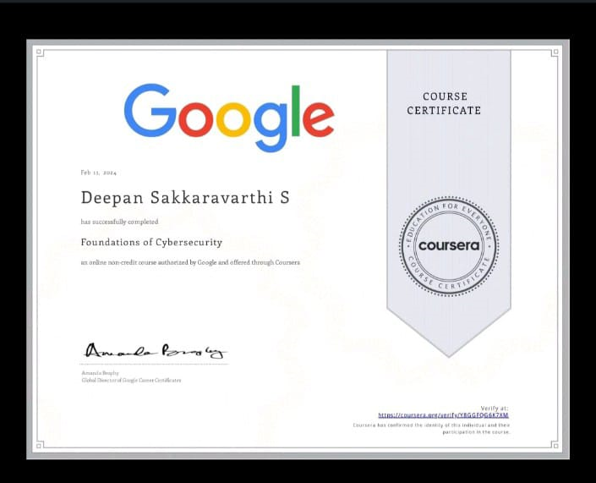
CERTIFICATION ON GOOGLE
I have Successfully completed the Foundation of Cybersecurity course and I will apply the learnt things related to Cybersecurity in my future.

Slide 15
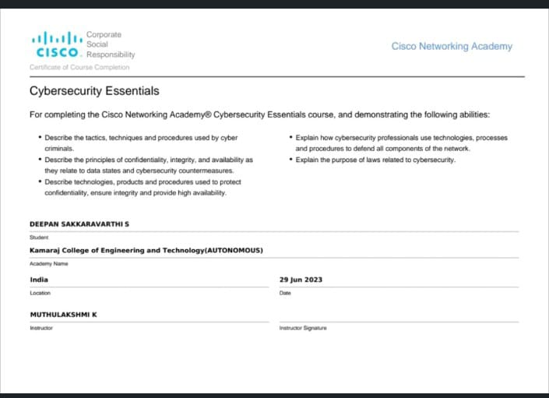

CERTIFICATION ON CISCO
I have earned certificate on “Cybersecurity Essentials” from Cisco networking academy. Ready to apply the skills obtained in my future.

Slide 16
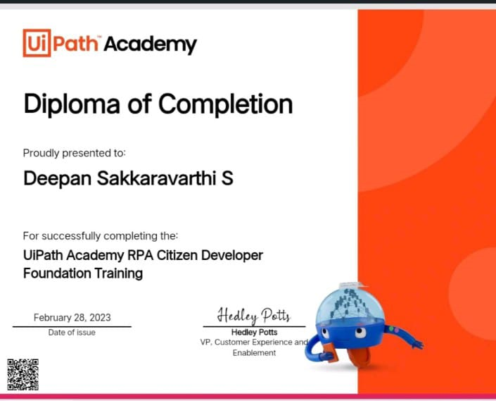

CERTIFICATION ON UI PATH ACADEMY
By completing 11 modules in RPA Citizen Developer Foundation Training. I have got credential from Uipath Academy.

Slide 17
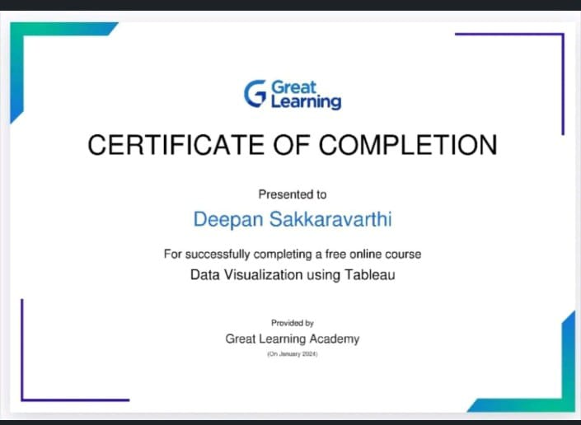

CERTIFICATION ON GREAT LEARNING
I have earned certificate on “Data Visualization” from Great learning. Ready to apply these skills in my career. and contributing to the emerging field of data visualization.

Slide 18
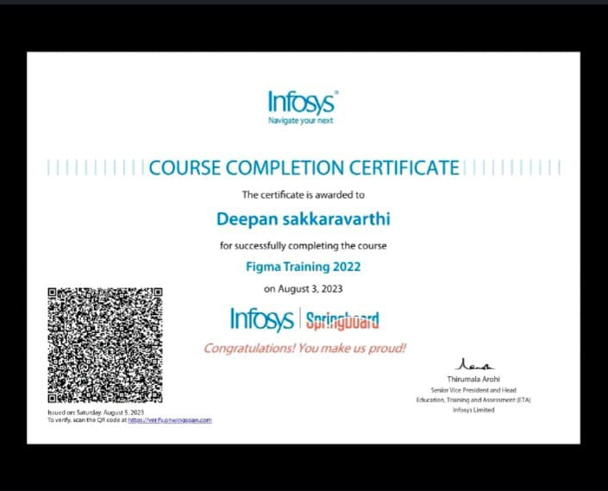

CERTIFICATION ON INFOSYS
I have earned the certificate on “figma basics” provided by the infosys springboard. And I have learnt how to create a UI and UX design interface using figma designing tool.

Slide 19
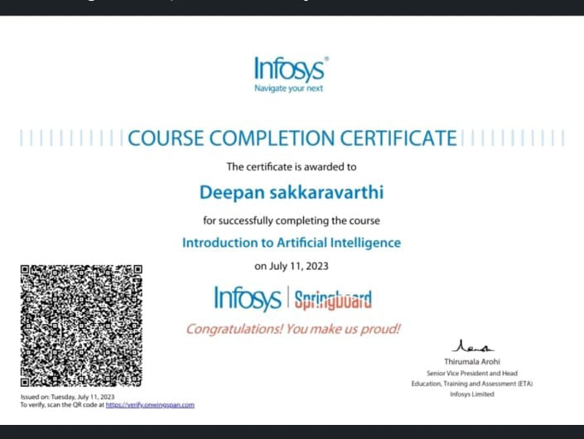
CERTIFICATION ON INFOSYS
I have earned the certificate on “introduction to artificial intelligence” provided by infosys springboard.

Slide 20
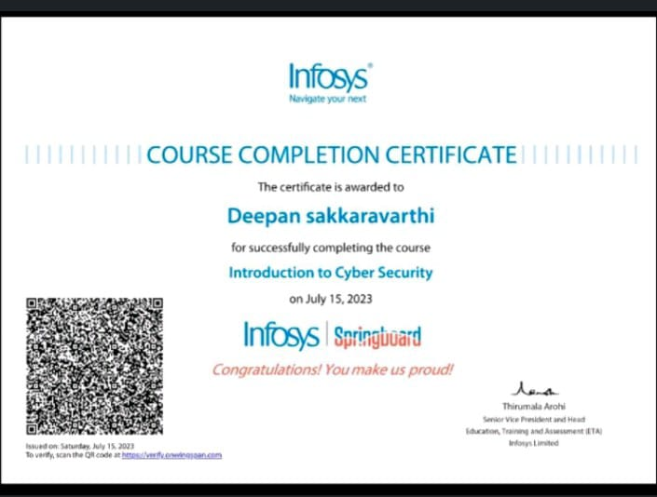
CERTIFICATION ON INFOSYS
I have earned a certificate on “Introduction to Cybersecurity”.Course provided by Infosys Springboard.

Slide 21
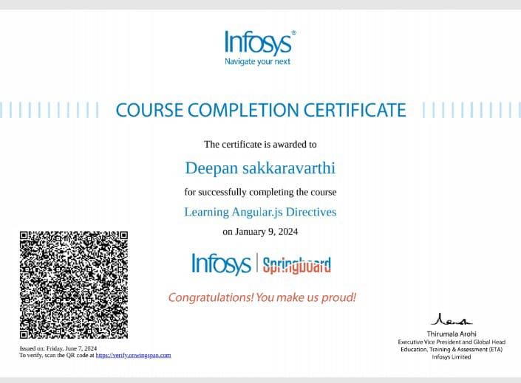
CERTIFICATION ON INFOSYS
I have earned a certificate on“Angular. jsDirectives”.Course provided by Infosys Springboard.

Slide 22
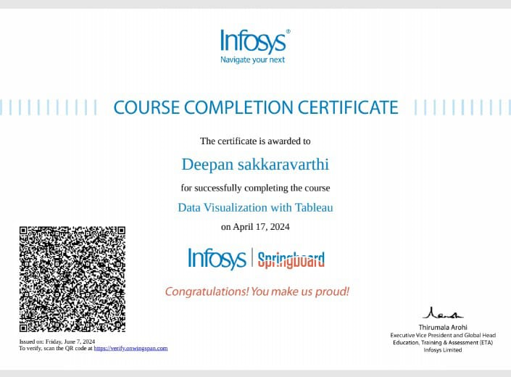
CERTIFICATION ON INFOSYS
I have earned a certificate on “Data Visualization With Tableau”.Course provided by Infosys Springboard.

Slide 23
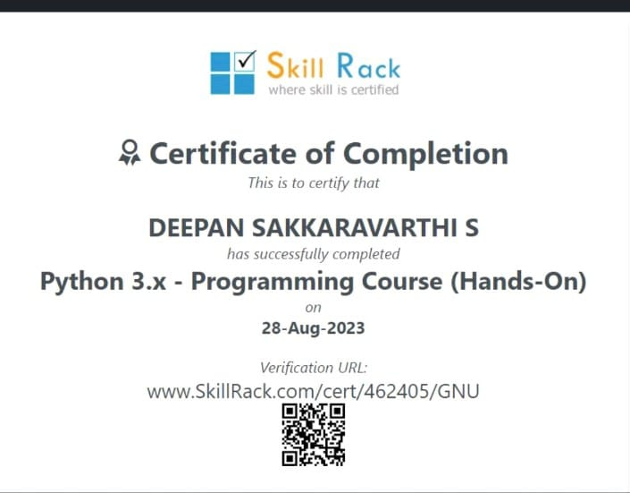

SKILL TEST- SKILL RACK
I have completed the skill test in Skill rack - Python programming (Hands-On) and received the skill test certificate from skill rack.

Slide 24
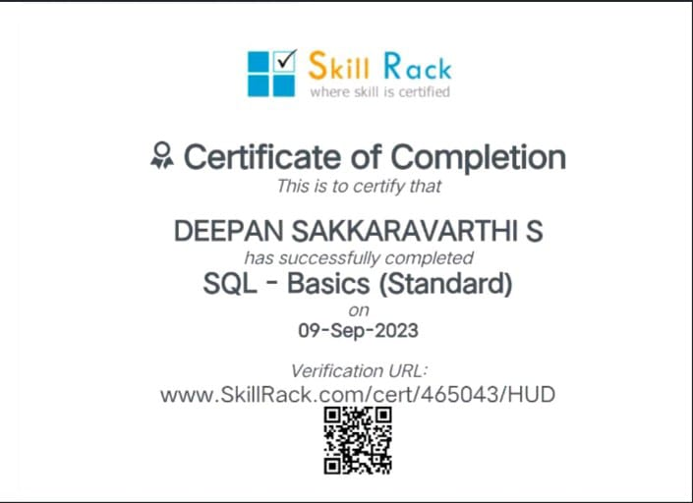
SKILL TEST - SKILL RACK
I have completed the skill test in Skill rack - SQL BASICS and received the skill test certificate from skill rack.

Slide 25
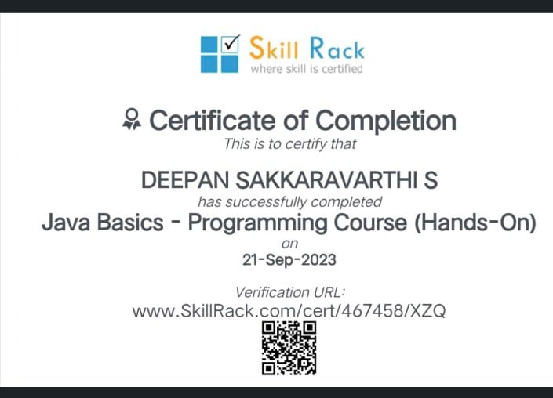
SKILL TEST- SKILL RACK
I have completed the skill test in Skill rack - Java programming (Hands-On) and received the skill test certificate from skill rack.

